Slide 1



Presentation for: [Insert Name, Title]
Date: [Inset Date]

Slide 2

Contents
Epta America & Chipita Int’l
Category/Market Landscape — Sweet Baked Goods
Our Portfolio / Lineup
7Days Performance
Our Supply Chain 101
What we/you need from you/us
Appendix — Shelf Sets // Other Markets

Slide 3

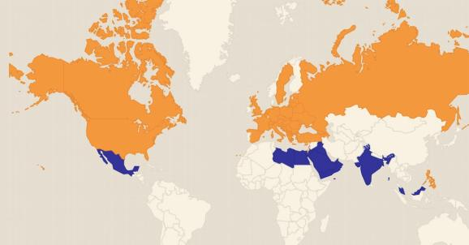

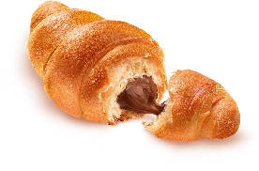


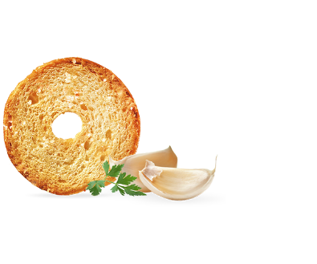

We [ ] are the NA subsidiary of Chipita international
Global Leader in Packaged Bakery
The WORLD’S
#1 BEST SELLING
30+ Years of Expertise
&
Strong global presence & demand
  Products sold in over 50 countries, leading in more than half
Large operation with ability to scale quickly
  $1 BILLION+ in annual sales; 11 plants & committed to building a US facility in 24 months
Focus on quality & sustainability
  GMO-free; 100% free range eggs; sustainable cocoa; sustainable palm oil
Shelf-Life advantage
  Shelf life ~2x better than Sweet Baked Goods (SBG) / Pastry competitors

Slide 4



Our Commitment to Social Responsibility
SUSTAINABILITY
RESPONSIBLE FARMING
EPTA America, in cooperation with our commercial partner, Chipita S.A., has long been committed to sustainable and responsible growth. Recent actions for footprint reduction include:
Invested €750MM between 2016-2018 to reduce environmental footprint of all production plants through coordinated actions
Reduced water consumption by 7.9% between 2017-2018
Recycled 4,099 tons of paper in 2018, offsetting the deforestation of 69,700 trees
Global Cage-Free Egg Initiative
In 2019, we made a global pledge to supply all eggs and egg products exclusively from cage-free breeding systems.
Supplier Selection
All of our supplier partners hold RSPO and UTZ accreditations and understand the value of sustainable farming.
COVID-19 RELIEF EFFORTS
OUR PEOPLE
  Chipita recently made a €500,000 donation to the General Hospital in Lamia, the town where Chipita’s main production plant is located, to combat COVID-19 related damages
  Helped the hospital to purchase intensive care respirators, surgical masks, goggles, uniforms, and other critical PPE
Chipita promises a fair, non-discriminatory work environment that recognizes and rewards effort and results to all employees around the globe. Below are some quick facts about our global team:
Chipita employs over 4,700 people worldwide
52% of Chipita employees are women
38% of middle & upper management is made up of women
Since the start of the Crisis, EPTA America has made regular food donations to essential care workers and those impacted COVID
Donations have been made to various food shelters, local hospitals, and assisted living homes

Slide 5
Sweet Baked Goods (SBG) :: Category/Market Landscape
Per IRI … Sweet Baked Goods = Pastry/Danish/Coffee Cakes*, Doughnuts, Cupcakes/Brownies, Muffins
*where 7Days lives; Pastry ~21% in Grocery, ~29% in C-Store — development opportunity
Note: updated in 2019
 | Total $ Size in $B | “historical” | “go forward “ | SS (<5oz) / MS | Reasoning
 |  | growth | growth | ~ % Split
Total | $7.8B | ++ | + | 35/65
C-Store* | $2.5B | ++ | + | 90/10 | - cont'd growth via new items (incl PL), slower rate
Grocery | $3.3B | + | + | 5/95** | - greater focus on fresh bakery & BFY
Mass (WM Only) | $1.3B | + | ++ | 5/95 | - from WM SBG Buyer, April 2019 (+6-7% in 2019)
Dollar | $0.4B | ++ | ++ | 20/80*** | - more “snack zones” in DT (1.3K today → 2K by YE19) - similar “snack zone” approach at FD (1K+ by YE19)
Club | $0.3B | + | 0 | 0/100 | - greater focus on in-store bakery, organic/BFY
Drug | $0.1B | 0 | 0 | 70/30 | - greater focus on fresh, BFY
Note: *stated price increases by competitors may result in stronger “go fwd” $ growth; we expect volume growth to be constrained
For Internal Only
Notes:
Update

Slide 6
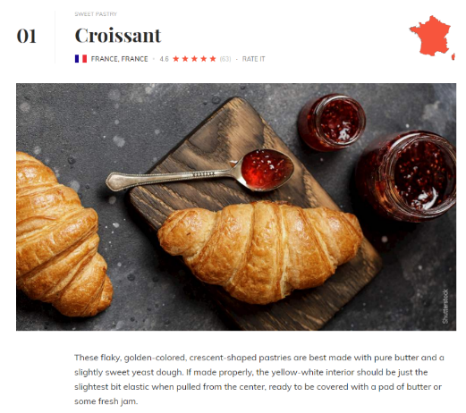
Did you know …
Croissants are the …
#1 most popular pastry in the world!
Pastry is…
underdeveloped in US Grocery
#1
Pastry Share of
Sweet Baked Goods
~21% in Grocery
vs.
~29% in C-Store
=
development opportunity
#2) Doughnuts
#3) Borek (Turkish pastry)
#4) Churros
#5) Baklava
#6) Éclair
#7) Cannoli
#8) Empanada
#9) Mooncake
#10) Profiterole
Source: https://www.tasteatlas.com/most-popular-pastries-in-the-world; IRI

Slide 7
A Little bit about our US Business
7Days plays in the ~$8B Sweet Baked Goods (SBG) category … where there’s been little innovative disruption; and we’re distinctive — no major direct croissant competitor.
To date → our focus has been generating awareness & trial thru the Convenience Channel with our 2.65oz single serve croissants
  Thanks to some of our key partners (7-11, Speedway, Sheetz, RaceTrac) — we are on track to have 50+ ACV/distribution in 2021 in Total US Convenience (at 47 ACV today)
We are now ready to take 7Days to the next level
  Committed to investing in the US — operations & marketing
Now → we’re starting to make major headway in the Dollar, Mass, and Grocery Channels
  In Summer 2020, we launched nationally at a Walmart & Family Dollar (note: we are already in Dollar Tree, HEB, Food Lion)

Slide 8









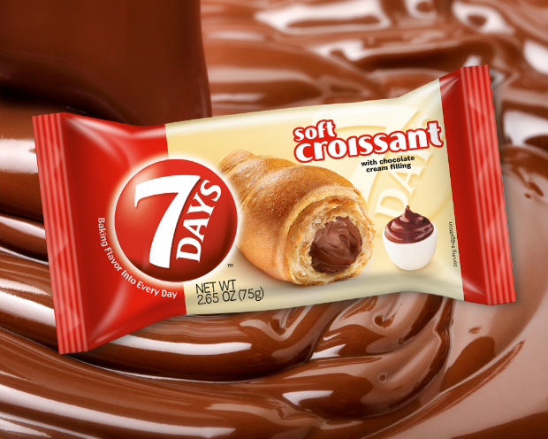





Our Retail Partners
Top #100
Retailer Rank in NA
- Food & Consumables -
Source: Progressive Grocer 2020
Grocery/Mass | Convenience | Dollar
#1
#23
#1 C-Store
#30
7000+ stores,
5 items in Nat’l PoG,
+2 items in H2 2020
Nat’l since 2017
2000+ Snack Zones, since 2018
National launch in June 2020
2800 Stores
#2
#35
#32
300+ Stores, 5 items
National launch in Aug 2020
6000 Stores
400+ reviews, averaging 4.4 stars
#17
#42
3000+ stores,
since Q4 2018
Launched in 2017
300 Stores as of May 2020
#11
#10
rotational program,
since 2017
In several US Divisions
incl southeast + Canada
#83
180 stores,
since 2018
Alabama
400+ Stores, 5 items

Slide 9


7Days % ACV Growth past 3 years – Total US
… 7Days is a Nat’l US brand / widely available — soon to be a key player in Sweet Baked Goods across channels!
+
+
Q1 2017
Q2 2017
Q3 2017
Q4 2017
Q1 2018
Q2 2018
Q3 2018
Q4 2018
Q1 2019
Q2 2019
Q3 2019
Q4 2019
Q1 2020
H2 2020
Note: H2 2020 projected based on est ACV of Walmart & Family Dollar
Source: IRI MULO + Convenience, past 3 years

Slide 10

Driving growth; Sweet Baked Goods & adjacent categories down
7Days vs Key Competitive Categories
-- NAT’L / Total US Conv --
$ % Sales Growth vs YA
L52 thru Dec 27, 2020
7Days is driving growth (+29%) vs Sweet Baked Goods ($2.5B) down (-6%)
Note: Pastry/Doughnuts is the largest category ($1.7B)
$31.2M
SOFT CROISSANTS
PASTRY/
DOUGHNUTS*
*7Days lives here
BAKERY
SNACKS
COOKIES
SNACK BARS/
GRANOLA BARS
TOASTER
PASTRIES/TARTS
Sweet Baked Goods
Note: Sweet Baked Goods (SBG) = Pastry/Danish/Coffee Cakes, Doughnuts, Cupcakes/Brownies**, Muffins; **same as Bakery Snacks
Source: IRI US Convenience, data thru Dec 27, 2020

Slide 11

Firing on all cylinders — across all key performance metrics
+29%
7Days $ % Growth vs YA
+ACV
% Growth vs YA
+Velocity
% Growth vs YA
+Core Items
% Growth vs YA
+New Items
% Contribution to Growth
+12%
ACV
+14%
U Velocity
+18%
$ Sales of
Top 4 “Core”
40%
$ Sales growth Contribution
Of New Minis
Note: 7Days is also seeing growth across ALL regions (+44% $ growth on avg)!
Note: Velocity = sales per point of distribution; Core = 2.65oz Chocolate, Vanilla, Strawberry & Vanilla, and Caramel
Source: IRI US Convenience, data thru Dec 27, 2020

Slide 12
Ranked #8 in $ Sales among Sweet Baked Goods MFRs & Climbing and is the fastest growing — #1 in % dollar growth + #1 in absolute dollar growth
Sweet Baked Goods (SBG) — $ Sales Rank by Manufacturer (x-PL) // Total US Conv
L52 thru Dec 27, 2020
Rank | Manufacturer (MFR) | $ Sales | % $ Growth | Abs $ Growth
 |  |  | vs YA | vs YA
1 | HOSTESS BRANDS LLC | $610M | -1% | ($6M)
2 | MCKEE FOODS CORP (Little Debbie, Drake's, Prairie City) | $450M | -13% | ($70M)
3 | BON APPETIT DANISH INC | $447M | -11% | ($11M)
4 | GRUPO BIMBO (Bimbo, Marinela, Entenmann's, Mrs. Baird) | $193M | -0.2% | (< $1M)
5 | FLOWERS FOODS LLC (Tastykake, Mrs. Freshley's) | $172M | -9% | ($17M)
6 | JAB HOLDING JOH A BENCKISER (Krispy Kreme) | $89M | -9% | ($2M)
7 | HORIZON FOOD GRP (Nemo's) | $33M | +8% | +$2M
8 | 7DAYS-EPTA America LLC | $31M | +29% | +$7M
9 | JTM FOODS INC (JJ's Bakery) | $13M | +10% | +$1M
10 | ARYZTA LLC (Otis Spunkmeyer) | $9M | -10% | ($1M)
11 | UNTD STATES BAKERY (Franz) | $9M | +5% | + < $1M
12 | CHATTANOOGA BAKERY INC (Moon Pie) | $9M | -10% | ($1M)
13 | THE BROWNIE BAKER INC | $9M | +4% | + < $1M
14 | GENERAL MILLS INC (Pillsbury) | $7M | -29% | ($3M)
15 | CAROLINA FOODS INC (Duchess) | $5M | -5% | (< $1M)
7Days is the fastest growing among the top 15 SBG MFRs … by a wide margin!
+29% YoY
Note: x-PL & < 2 ACV, Prairie City acquired by McKee in May 2019; Sweet Baked Goods (SBG) = Pastry/Danish/Coffee Cakes, Doughnuts, Cupcakes/Brownies, Muffins + items across McKee, Hostess, Moon Pie falling into Cookies IRI Category
Source: IRI US Convenience, data thru Dec 27, 2020

Slide 13
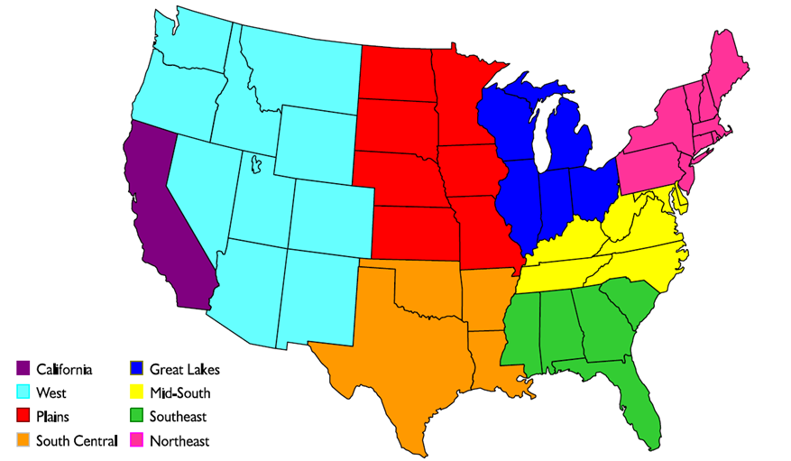
Strong presence / widely available; near 50% ACV nationally
7Days
Nat’l
C-Store ACV:
49%
+5pts vs YA
ACV vs YA:
+12%
TDPs vs YA: +43%
7Days // Conv ACV
Total & by Region
L52 thru Dec 27, 2020
= cont’d item expansion!
Major Coastal strength,
especially California region @ 80% ACV
49%
+4pts
41%
+5pts
18%
+3pts
37%
+4pts
80%
+6pts
55%
+5pts
57%
+9pts
51%
+5pts
Note: TDP = Total Distribution Points = ACV x Avg Items Carried
Source: IRI US Convenience, data thru Dec 27, 2020

Slide 14
Growth across regions – both distribution + velocity
7Days -- NAT’L / Total US Conv & Regions --
L52 thru Oct 4, 2020
Geography | $ Sales | $ Sales % Chg vs YA | ACV | ACV % Chg vs YA | $ Velocity Sales per Pt of Distribution | $ Velocity % Chg vs YA | U Velocity Sales per Pt of Distribution | U Velocity % Chg vs YA
Total US - Conv | $29,531,409 | 32% | 47.1 | 11% | $626,481 | +19% | 370,052 | +19%
Northeast | $5,084,051 | 10% | 48.8 | 11% | $104,271 | -1% | 60,602 | 0%
California | $4,896,741 | 30% | 79.2 | 10% | $61,853 | +18% | 34,215 | +18%
South Central | $4,551,217 | 11% | 52.6 | 11% | $86,465 | 0% | 51,109 | -1%
Southeast | $4,503,227 | 49% | 50.1 | 17% | $89,973 | +27% | 56,235 | +26%
Mid-South | $4,157,666 | 40% | 52.6 | 8% | $79,031 | +30% | 47,726 | +29%
West | $3,194,077 | 47% | 40.5 | 11% | $78,784 | +33% | 46,295 | +34%
Great Lakes | $2,541,951 | 79% | 35.3 | 6% | $72,080 | +70% | 43,063 | +71%
Plains | $602,480 | 140% | 17.7 | 44% | $34,125 | +67% | 20,900 | +53%
Note: Velocity = sales per point of distribution
Source: IRI US Convenience, data thru Oct 4, 2020

Slide 15
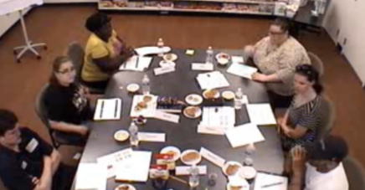
recent qual research study with grocery/mass shoppers— very positive reactions from consumers to 7Days product and value proposition
Conducted six 2-hour focus groups with Grocery & Mass shoppers (30+) in June 2019 in Hackensack, NJ and Charlotte, NC
Key Insights
Positive reaction from Shoppers/Consumers — 7Days items described as “unique” and “appealing”
Strong consideration & purchase intent
Post trial/taste expectations exceeded
Premium perception — most expressed higher willingness to pay
Note: video clips available upon request
Source: June 2019 Consumer Qualitative Study in Charlotte, NC & Hackensack, NJ conducted by Blueberry (agency)

Slide 16




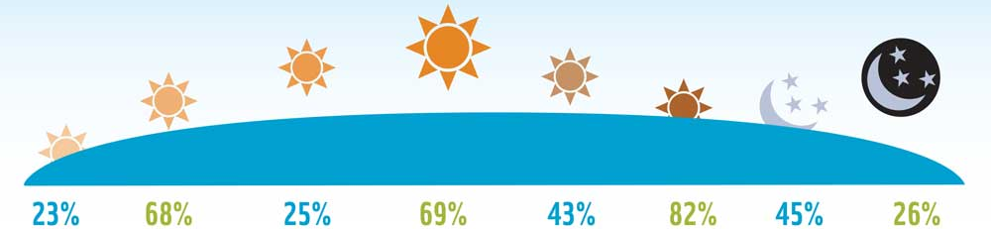

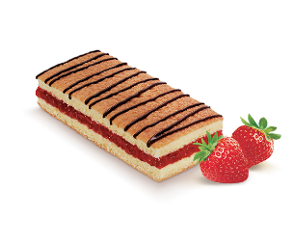
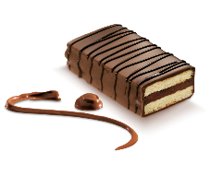

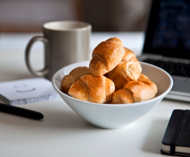


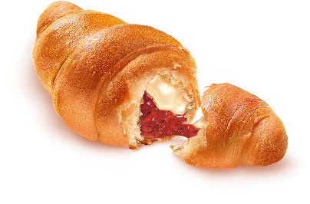


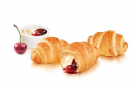
Our 7Days croissant items anchor to the morning and afternoon occasions, across all consumers
occasions are relevant to all consumers
Eating Occasion / Day Part
Source Hartman
Primary anchor ::
complement to your morning coffee or tall glass of milk.
Secondary anchor ::
Perfect for that afternoon break.
Innovation Pipeline
Light & Sweet for that evening treat.
Snackable
Shareable
Save, eat later
Easy to grab & go
Key Attributes
Keeps you full / satisfying
Easy to grab & go
Did You Know
60% of Americans prefer to eat many small meals throughout the day, as opposed to a few large ones
Source: Harris Poll, 2019 State of Snacking Report

Slide 17
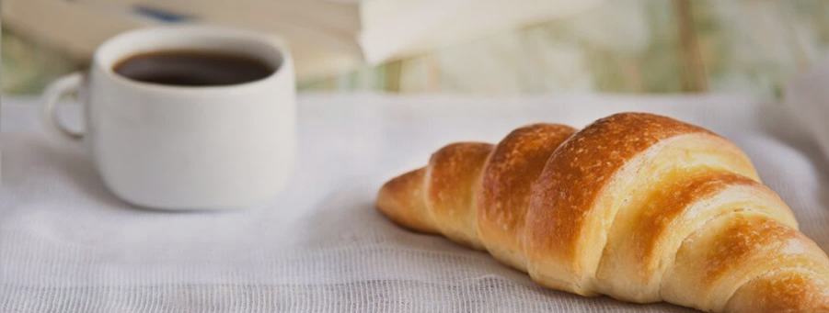


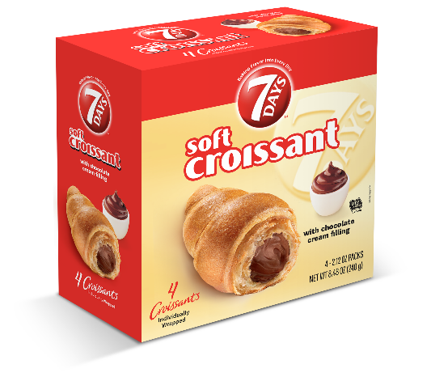
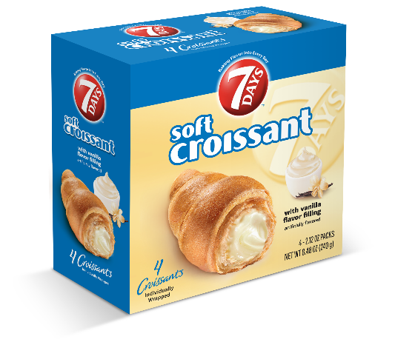
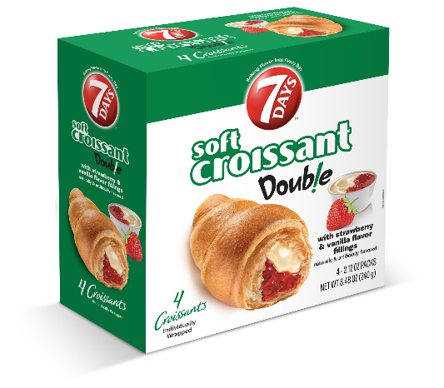

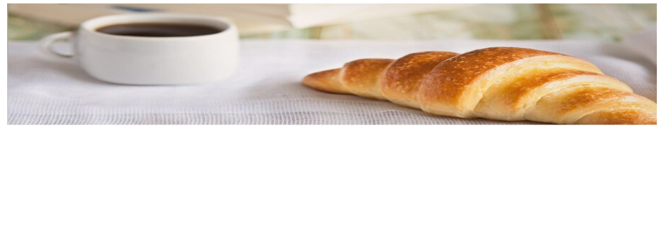
4-Count
Multipack
THE BEST-SELLING PACKAGED CROISSANT IN THE WORLD!
Wonderful combo of soft pastry with rich cream & fruit fillings
4-count box is ideal for the whole family
2.12oz size makes it a perfect lunchbox snack
2x shelf life of leading competitors – 75+ Days
List Cost: $2.59
SRP: $3.99
GM: 35%
Promo*:
2 for $7 & 2 for $6
*Trade funds available for promotions

Slide 18
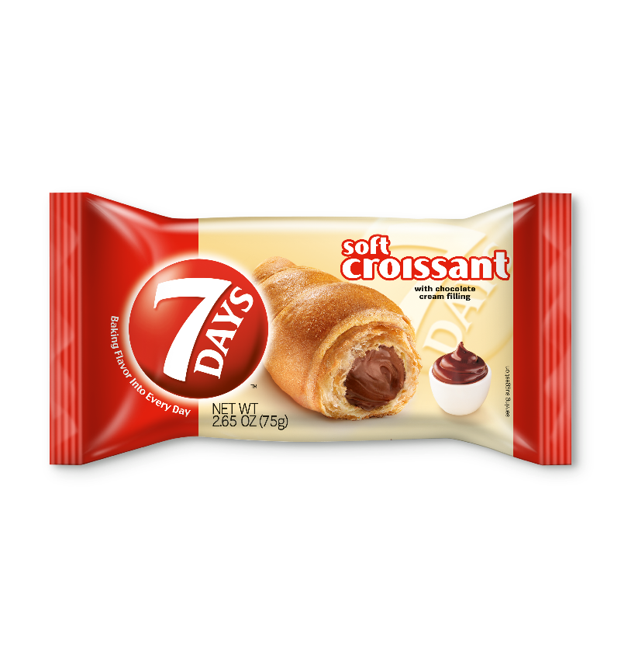
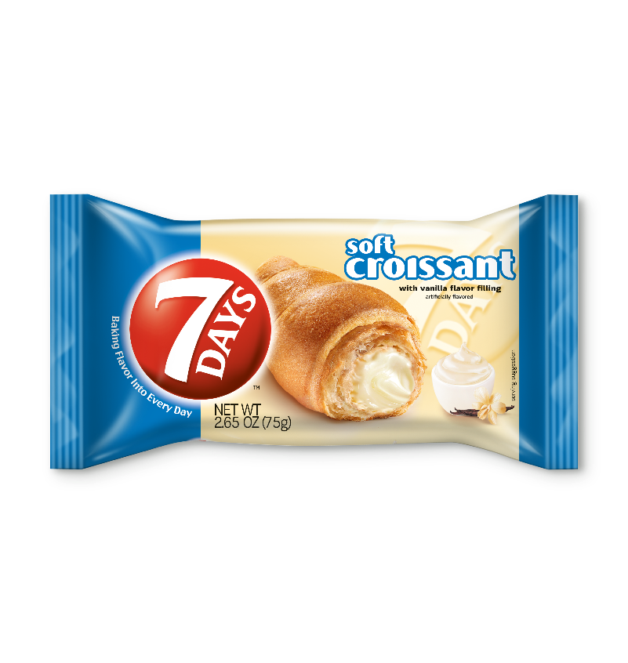
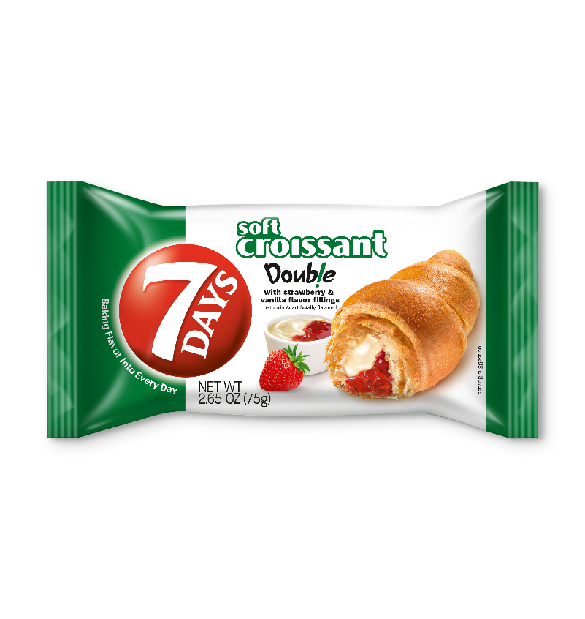
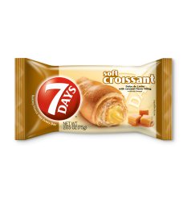
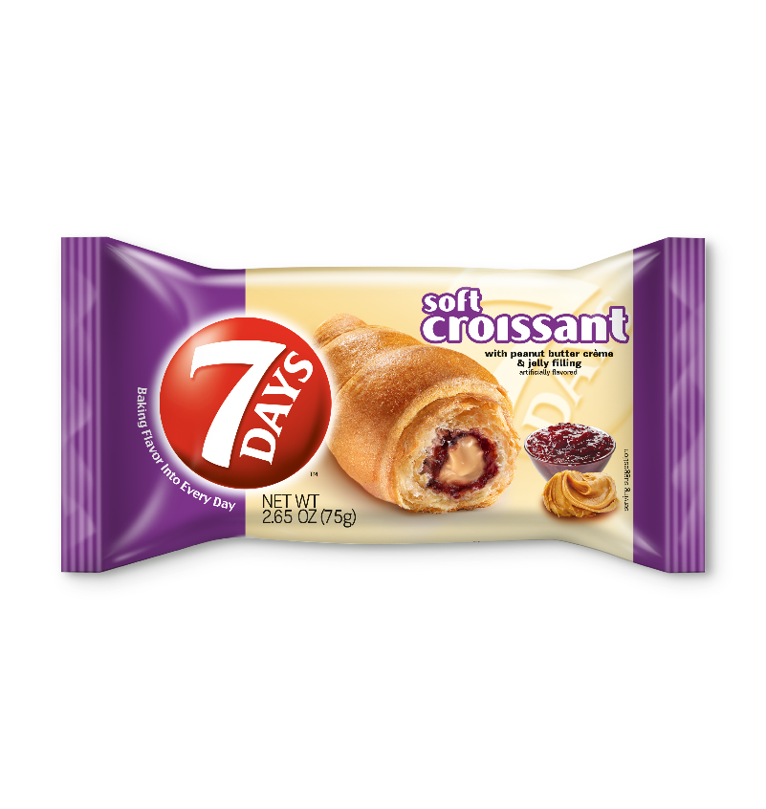
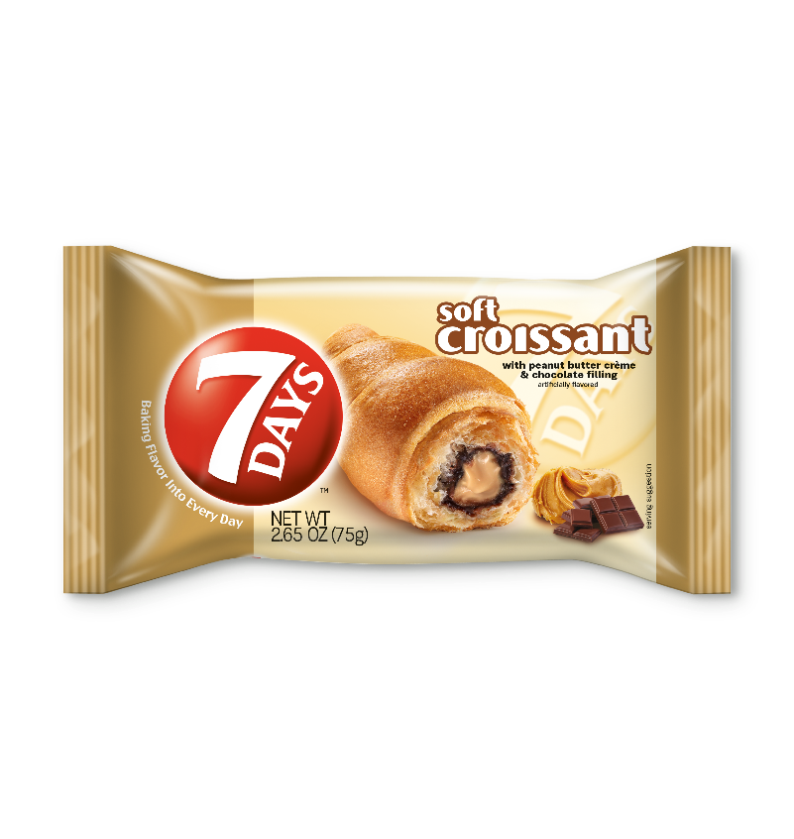

Single-
Serve
THE BEST SELLING PACKAGED CROISSANT IN THE WORLD!
Wonderful combo of soft pastry with rich cream & fruit fillings
6ct box ideal for any store shelf
2.65oz size great for grab & go and indulgent impulse item
2x shelf life of leading competitors – 75+ Days
List Cost: $.84
SRP: $1.29
GM: 35%
Promo*:
5 for $5
*Trade funds available for promotions

Slide 19



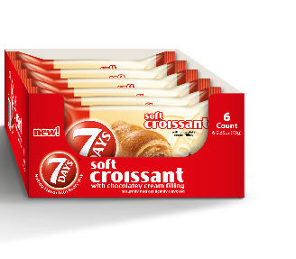
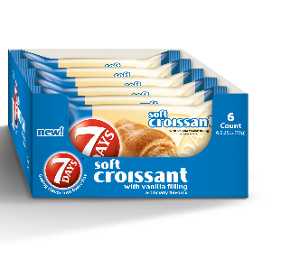
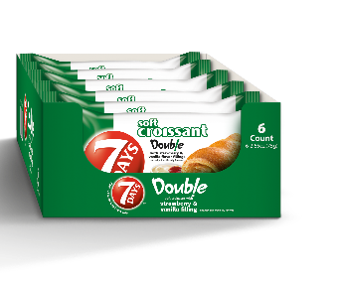
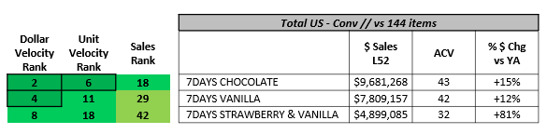
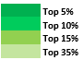
7Day(s) items are top-ranked on productivity:
Chocolate is #2 & Vanilla is #4 in $ Velocity in the US Conv IRI!
$ Velocity Rank // 7Days vs. Competitive Items
Still climbing the ranks …
+62% $ growth vs YA
Rankings
vs. 144 items
Chocolate
Vanilla
Strawberry & Vanilla
Total US
#2
#12
#4
#8
Note: Items > 5 ACV, x-PL, < 6 oz / Single Serve; Cookies-Morning Foods [Select] based on brand aggregates, see prior slides; Velocity = $ or Units per point of distribution (PPD)
Source: IRI Total US Convenience, data thru July 12, 2020
Notes:
Discuss with Bill

Slide 20
Core items are strong performers — top ranked on $ sales, velocity and growth / continuing to climb; new MINIs top ranked on growth
 |  | Top 10%
 |  | Top 15%
 |  | Top 33%
 |  | Top 50%
Key 7Days Items vs Sweet Baked Goods // Total US Conv
L52 thru Dec 27, 2020
 |  |  |  | Total US - Conv // vs 464 items
Sales Rank |  | Abs $ Growth Rank |  |  | $ Sales Curr | ACV | % $ Chg vs YA
61 |  | 58 |  | 7DAYS CHOCOLATE | $9,756,050 | 44 | +7%
70 |  | 76 |  | 7DAYS VANILLA | $8,010,047 | 43 | +5%
94 |  | 15 |  | 7DAYS STRAWBERRY & VANILLA | $5,927,493 | 36 | +64%
178 |  | 55 |  | 7DAYS CARAMEL | $2,326,945 | 22 | +39%
259 |  | 33 |  | NEW! 7DAYS MINI CHOCOLATE pouch | $1,201,760 | 16 | NEW
326 |  | 47 |  | NEW! 7DAYS MINI VANILLA pouch | $775,102 | 12 | NEW
336 |  | 51 |  | NEW! 7DAYS MINI CHERRY & VANILLA pouch | $720,587 | 13 | NEW
Core 3 Croissant items
in top half of
$ and Unit velocity —
Chocolate
Top 1/3
Vanilla
Top 2/5
Strawberry & Vanilla
Top 1/2
Note: x-PL & < 3 ACV, Sweet Baked Goods (SBG) = Pastry/Danish/Coffee Cakes, Doughnuts, Cupcakes/Brownies, Muffins + items across McKee, Hostess, Moon Pie falling into Cookies IRI Category
Source: IRI US Convenience, data thru Dec 27, 2020

Slide 21
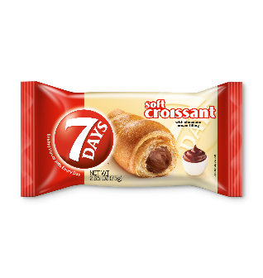
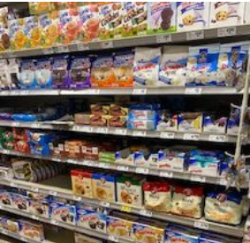
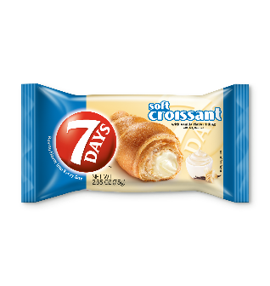
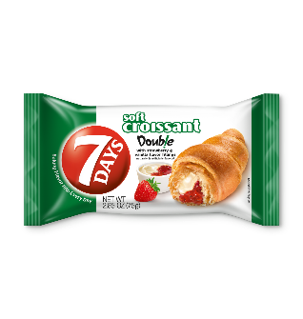
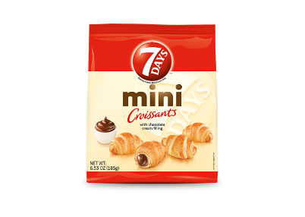
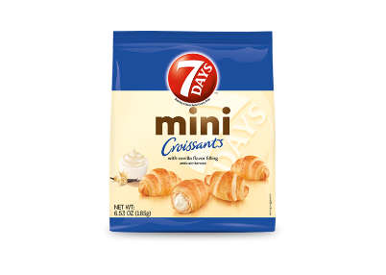
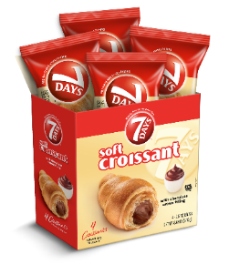
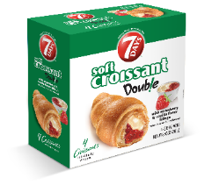
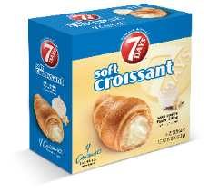
7Days performance & expansion — real example at a MAJOR SOUTHWEST GROCERY RETAILER
2017
2018
2019
2020
+4 Items Launched
+1 Item
Cont’d expansion & Growth of all other items
Cont’d Growth of items
+3 new multipack items / all incremental
1
+37%
+27%
2
+23%
+25%
3
+21%
4
5
+32%
flat
Launched
May 2020
Units per
Store
per
Week
1 | 2 | 3 | 4 | 5 | 6 | 7 | 8 | Total
10 | 9 | 8 | 7 | 5 | 7 | 6 | 6 | 58
8
6
7
Note: % growth based on like months vs YA
Source: Internal & Retailer Data

Slide 22
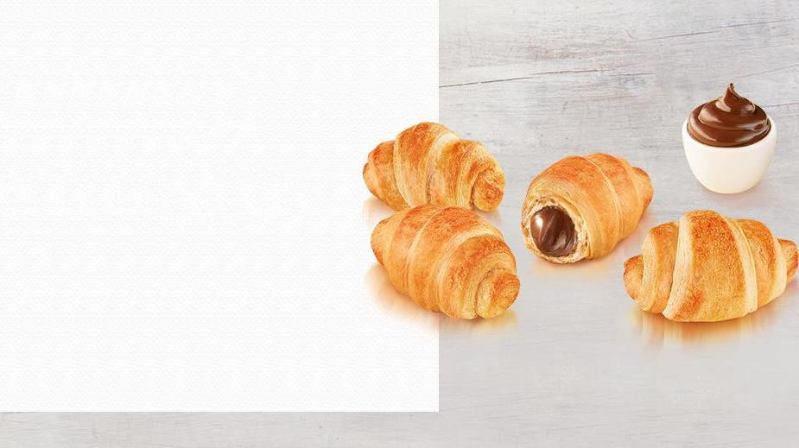


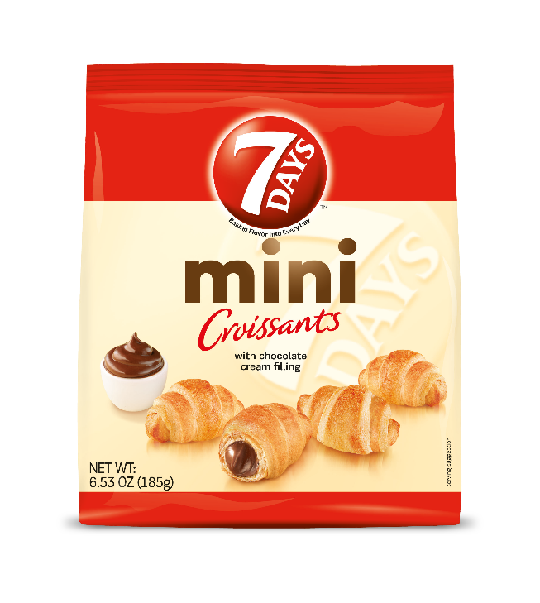
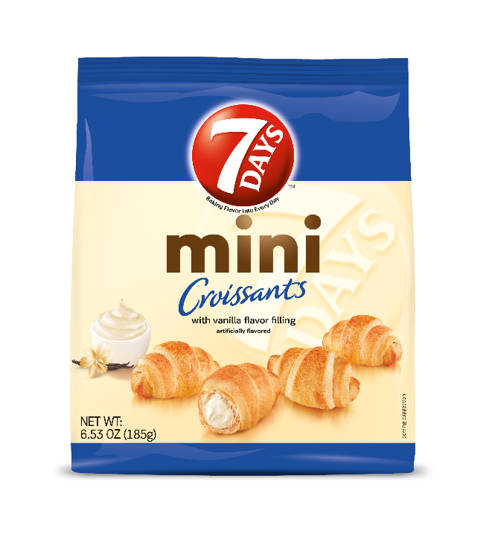
Bite-sized satisfaction of a world favorite
Perfect snack for anytime of day
Ideal size to share with the family or friends
Unique snack like no other
Large Bag Mini Croissants
List Cost: $1.79
SRP: $2.99
GM: 40%
Promo*: 2 for $5
*Trade funds available for promotions

Slide 23
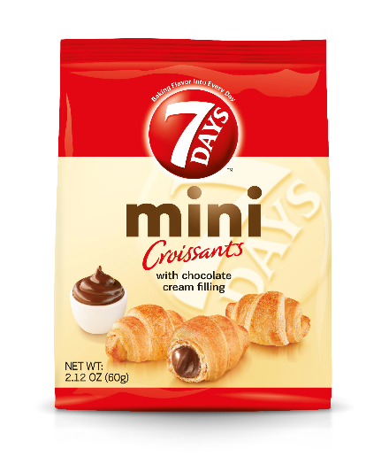
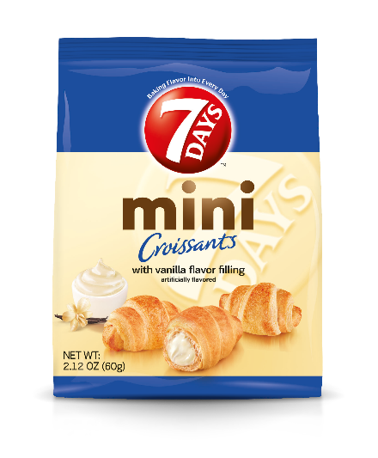
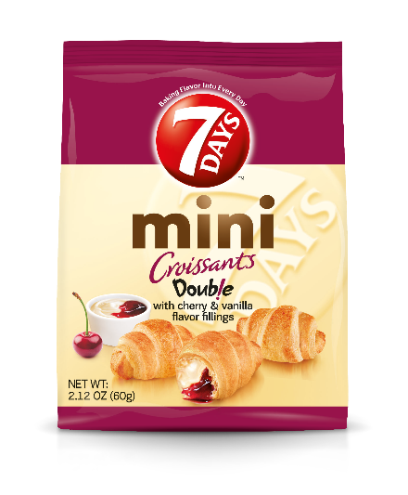
Bite-sized satisfaction of a world favorite
Perfect snack for anytime of day
5 miniature croissants in each pack
Unique snack like no other
Small Bag Mini Croissants
List Cost: $.84
SRP: $1.29
GM: 35%
Promo*: 5 for $5
*Trade funds available for promotions

Slide 24

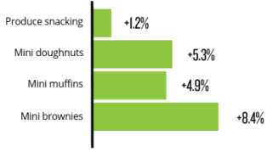
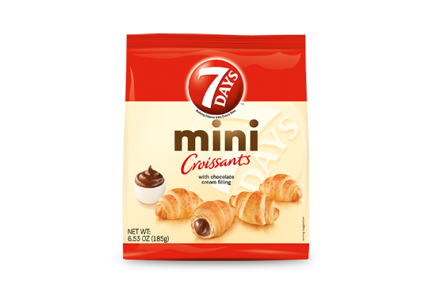
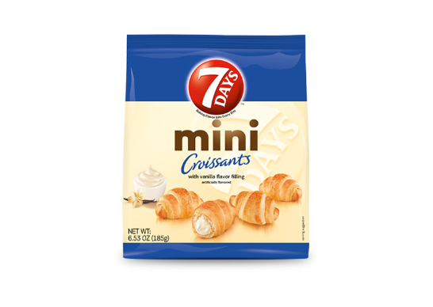
Mini Croissants on trend with consumer preferences!
5 mini croissants filled with creamy fillings in each single serve packet
  New Cherry & Vanilla offers additional fruit led flavor
Why Mini’s?
  Mini snacks on trend with consumers!
    “The snack attack continues to grow among healthy snacks
    and those that offer “mini” indulgences.”
    Source: https://www.nielsen.com/us/en/insights/article/2019/fresh-trends-tracking-the-four-trends-driving-growth-across-fresh/
  Balance is key for today's snackers
    Always room for another healthy snack, but there is also room for another indulgent treat.
    Today's consumers are finding ways to juggle "the good" and "the bad" when snacking.
    Source: 5 Snack Trends to Know, May 10, 2019 , Marcia Mogelonsky, Direct of Insights, Mintel
  Ease of consumption and portion control
  Attracts different usage occasion

Slide 25
And the new Mini Croissant pouches have proven incremental
7Days Total & by Item — $ Sales & Growth // Total US Conv
L24 thru Oct 4, 2020 / Q2 & Q3 2020
 | $ Sales L24 thru Q3 | $ Sales L24 thru Q3 - YA | Abs $ Chg
7 DAYS Total | 15,141,618 | 11,503,058 | +3,638,560
CHOCOLATE, 2.65 OZ | 4,722,634 | 4,281,334 | +441,300
VANILLA, 2.65 OZ | 3,865,490 | 3,613,635 | +251,855
STRWBRY & VANILLA, 2.65 OZ | 2,939,937 | 1,726,460 | +1,213,477
CARAMEL, 2.65 OZ | 1,113,782 | 904,283 | +209,499
new! CHOCOLATE MINI, 2.12 OZ | 585,003 |  | +585,003
PNUT BTR & JLY, 2.65 OZ | 571,504 | 450,621 | +120,883
new! VANILLA MINI, 2.12 OZ | 404,249 |  | +404,249
PB CHOC, 2.65 OZ | 379,840 | 338,079 | +41,761
new! CHERRY & VANILLA MINI, 2.12 OZ | 373,831 |  | +373,831
COCOA MINI, 6.53 OZ | 109,116 | 119,727 | (10,611)
VAN MINI, 6.53 OZ | 76,232 | 68,919 | +7,313
Total MINI Croissants (new 2.12oz + 6.53oz) | 1,548,431 | 188,646 | +1,359,786
Total Core Croissants (2.65oz) | 13,593,186 | 11,314,412 | +2,278,774
+40%
growth contribution!
Source: IRI US Convenience, data thru Oct 4, 2020

Slide 26
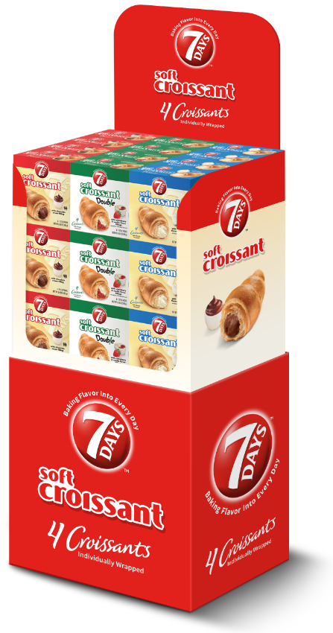
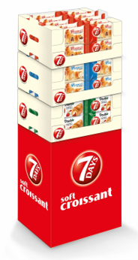
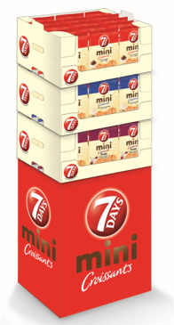
Croissant Merchandising Tools
Croissant Floor Shippers
Multi-Pack // Single-Serve // Minis
36ct Multi-Pack
60ct Single-Serve
45ct Mini Croissant
Notes:
Make images bigger

Slide 27





Soft sponge cake, with a layer of fruit and cream fillings
Delicious melt in your mouth treat with a soft, light bite
Ideal snack for anytime of day
2.12oz size fits perfectly in the lunchbox
List Cost: $.62/unit
SRP: $1.00/unit
GM: 38%
Promo Funds Available!

Slide 28


New! 7Days Cake Bars
need for quality at a great price → led to 7Days Cake Bars
Available
January 1, 2021
SRP: $1.29
Delivered Price: $0.62
52% margin!
Note: SBG = Pastry/Doughnuts, Bakery Snacks + several Little Debbie items falling into Cookies
Source: IRI US Conv thru 7.12.2020; https://www.iriworldwide.com/IRI/media/Library/U-S-CPG-Growth-Leaders-TL_aug20.pdf

Slide 29

New! 7Days Cake Bars
concept & value proposition resonated strongly with consumers
+Strong Flavor Appeal
did you know
Chocolate & Berry are top ranked flavors among Sweet Snacks!
Source:
- The NPD Group/SnackTrack
- Zappi Concept Test, August 2020 (sample of 150 consumers)

Slide 30
New! 7Days Cake Bars key consumption occasion for cake bars is afternoon snacking
If you were to purchase a 7Days Cake Bar,
what meal occasions would you most likely consume it?
(N = 150)
Please select all that apply.
Most likely to be consumed as a…
Afternoon Snack
Mid-morning Snack
After Dinner Snack
Note: We can expect Cake Bars to be highly incremental to Croissants.
Source:
- Zappi Concept Test, August 2020 (sample of 150 consumers)

Slide 31







SKU Priority
Rank
#1
#2
#3
#4
High quality bagel chips at a better value
Flat-bottom bag perfect for any shelf
Pairs perfectly with cheeses and spreads
Shelf-Life: 7+ months upon receipt
Available in 2 sizes: 8.81oz & 3.17oz
Big Bag 8.81oz
List Cost: $1.79 → SRP: $2.99
GM: 40%
Small Bag 3.17oz
List Cost: $.84 → SRP: $1.29
GM: 35%
Notes:
Update pricing section

Slide 32



Bagel Chips :: 3 primary occasions
Excellent grab & go complement to any lunch —
… delicious on its own or as a crunchy companion to a soup or salad!
Lunch
companion.
Perfect for that afternoon break —
… when you’re looking for something to tide you over or just crunch on!
Afternoon
munching.
Great for entertaining / sharing —
… perfect for a small sports watching with friends or a more special event*
Entertaining
appetizer.
*Because of the softer bite, 7Days Bagel Chips pairs nicely with cheeses, spreads, and other toppings!

Slide 33




Bagel Chips :: Quality, Value & Performance
Product
Performance
-- At a major SW Grocery Retail Partner --
  Product Quality: All Natural, No Preservatives, No Flavor Enhancers, Simple Ingredient List, Sustainably-Sourced, GMO-free
  Product Experience: Softer bite vs. competing brands — perfected by Bagel Chip/Crisp creator, Jim Burn III (EPTA Chairman)
  Product Life: manufactured with 14 months (guarantee 210 days to your dock)
  Product Value: available to you & the consumer at a 22% more value vs. key bagel chip competitor, 8.81oz v 7.2oz
7Days items:
~11-12
units per store per week
with key competitor also in distribution. should be 2x without!

Slide 34
Supply Chain 101
Croissants & Bagel Chips
  Manufactured in Bulgaria
  ~30 days transit time
Croissants, produced with 5 months / 150 days → arrives with ~120 days
  Bagel Chips, produced with 14 months, 420 days → arrives with ~270 days
  Pizzeti Chips, produced with 10 months, 300 days → arrives with ~200 days
  PO lead time for open stock = 10 business days for turn biz, 10 weeks for pipe fill
  PO lead time for shippers = 30 business
Guarantee to Retailer/Wholesaler dock
  75 days for All Croissants
  210 days for Bagel Chips
  120 days for Pizzeti’s

Slide 35



Broker Portal
Easily accessible online resource tool for all broker partners providing all the latest information, images, and marketing materials
Step 1: Access EPTA Website: www.eptaamerica.com
Step 2: Scroll to bottom of home page & click
Step 3: Enter password (provided by EPTA sales rep)
Step 4: Select category to few drop down list of files
Step 5: Click link to view/download files
NOTE: Password update every 90 days from EPTA

Slide 36


Planning tools ………………………… examples
Forecast & Planning Tool
Retailer Promo
Calendar

Slide 37




Slide 38




… with out new Mini pouches!

Slide 39






Over $1 Billion Annual Sales OVER SEAS
Greece
Romania
England
Greece
Slovakia
Russia

